Slide 1
Visualization on different age groups targets for Heart Disease
Projection of Data on Heart Disease Targets to Cardiologist

Slide 2
Projection of data to Cardiologist on age group with likely targets for Heart Disease
Healthcare Data on Heart Disease
Data has been taken from: https://www.kaggle.com/ronitf/heart-disease-uci
Targets of heart disease in particular age group

Slide 3
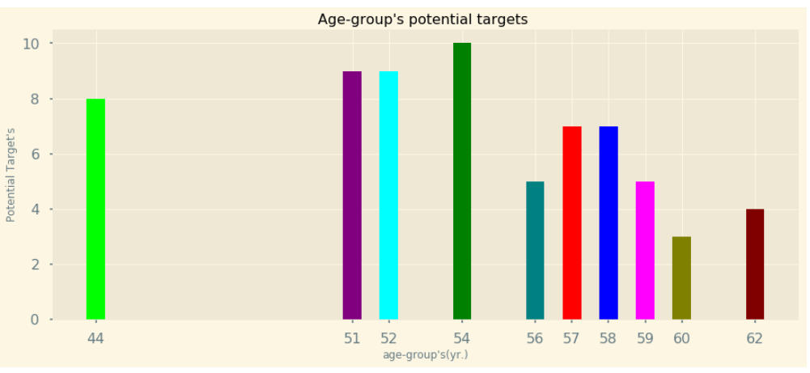
Potential targets based on age groups
9
9
8

Slide 4
Characteristics obtained from the graph with age group who are targets of heart disease
Highest number of targets were in age of 54
Range of the highest targets range from 51 to 54
Individuals with age group range from 51 to 62 are most likely targets for heart disease
The early period for the heart disease for individuals is seen at the age of 44

Slide 5
Inferences from the data points on heart disease.
The targets for heart diseases are seen for the age group of 44 and 62.
Step 1
Age :
44 and above
Step 2
Heart checkups:
Chol, ecg, cp, bp
Step 3
Target level:
High

Slide 6

THANK YOU
Trishala Basti (Student of ELU)

